Slide 1
Knights Charge 5/12
Describe Nixon’s Foreign Policy. What were some things he did to improve relations with other countries?
Describe Nixon’s Domestic Policy
What did economists call the economy?
What was the decision of the University of California vs. Bakke court case?
What happened at Watergate and what did Nixon do?

Slide 2
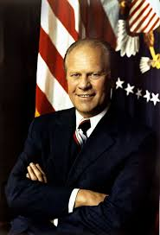
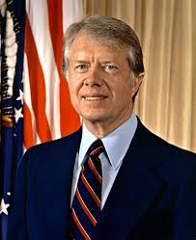
The Ford and Carter Years

Slide 3
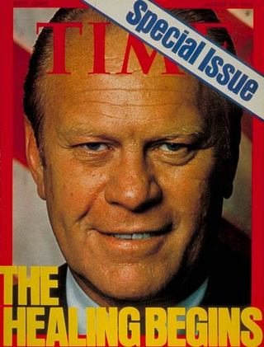
Ford Pardons Nixon
After Nixon resigns, Ford pardons Nixon of all wrongdoing
He is forgiven for Watergate by Ford
Received much backlash

Slide 4
Ford Continues Nixon’s Plan
Ford’s foreign policy very similar to Nixon
Détente with USSR
Helsinki Accords- attempt to improve relations with Communist European countries
SALT II- two nations pledged to limit nuclear arms production

Slide 5
Ford and the Economy
Economy was still experiencing stagflation
In an attempt to fix the economy, Ford passes “Whip Inflation Now (WIN)
WIN failed

Slide 6
Carter Changes Course
Carter favored foreign relations based on human rights
Focused on citizens in the developing world
After USSR invaded Afghanistan, US placed sanctions on USSR
US boycotted the 1980’s Summer Olympics

Slide 7
1980 Winter Olympics
Cold War played out on the ice as the US Hockey team upsets the USSR hockey team in a shocking upset
https://www.youtube.com/watch?v=tdmyoMe4iHM

Slide 8
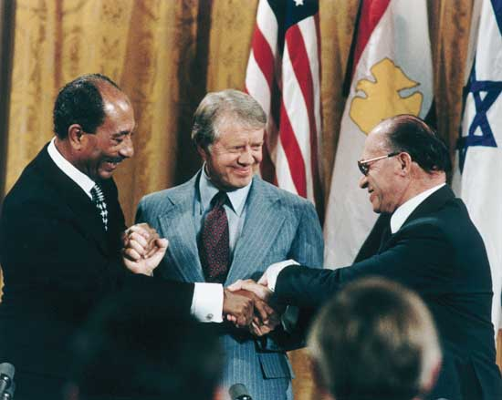
Carter Makes Peace
Camp David Accords- Peace agreement between Israel and Egypt
Organized by Carter

Slide 9
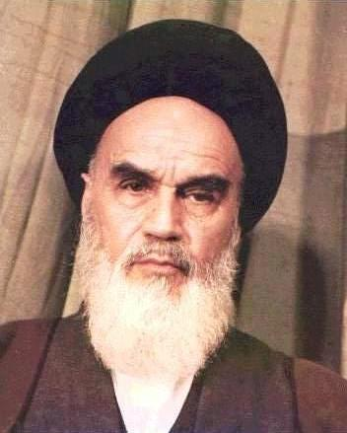
Problems in Iran
US Supported the Shah of Iran who is opposed by Muslim radicals in Iran
Iranian Revolution- led by Ayatollah Khomeini which forced the Shah to flee

Slide 10
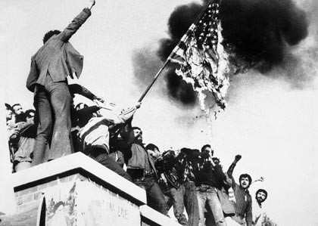
Iran Hostage Crisis
Iran Hostage Crisis- After Shah flees to US, Iranian capture US embassy taking 66 US hostages
Carter’s inability to free hostages ruins his presidency

Slide 11
Argo
https://www.youtube.com/watch?v=w918Eh3fij0

