Slide 1
Knights Charge 4/14
What was the strategy used by the Americans in the Pacific when fighting the Japanese? Who led this assault?
Where was the D-Day invasion? When did it happen?
What was the significance of the Battle of the Bulge? Who led the rescue?

Slide 2
End of World War II and its Effects

Slide 3
Learning Targets
You will be able to analyze what the US did to end the war with Japan
You will be able to describe the United Nations
You will be able to identify where Nazi war criminals were prosecuted

Slide 4
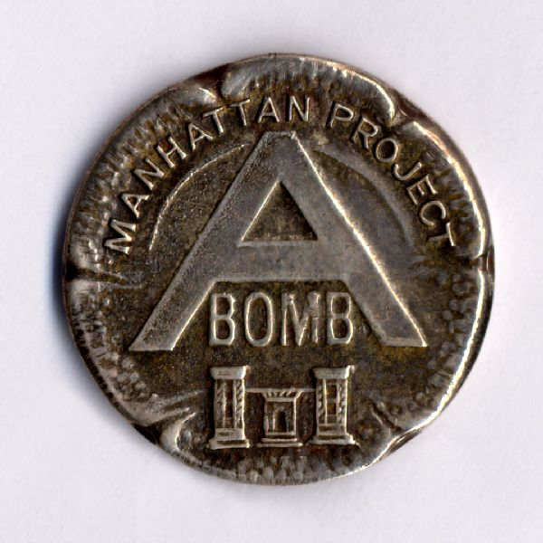
The Atomic Bomb Ends the War
Albert Einstein warns the Americans that they should proceed with developing an atomic bomb
The program to build the atomic bomb was known as the Manhattan Project
Led by J. Robert Oppenheimer

Slide 5
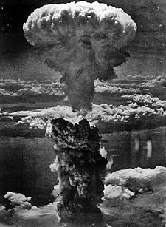
Truman Drops the Bomb
Truman saw this as an opportunity to end the war and save American lives.
August 6, 1945, the Enola Gay dropped the first atomic bomb on Hiroshima
August 9, another bomb was dropped on Nagasaki

Slide 6
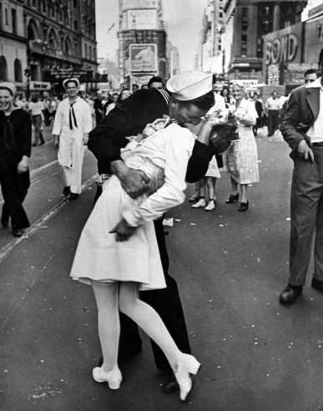
The War is Over
August 15, 1945, the Japanese surrender to the US signaling the end of the war. (V-J Day)
May 7, 1945 Germany surrendered (V-E Day)

Slide 7
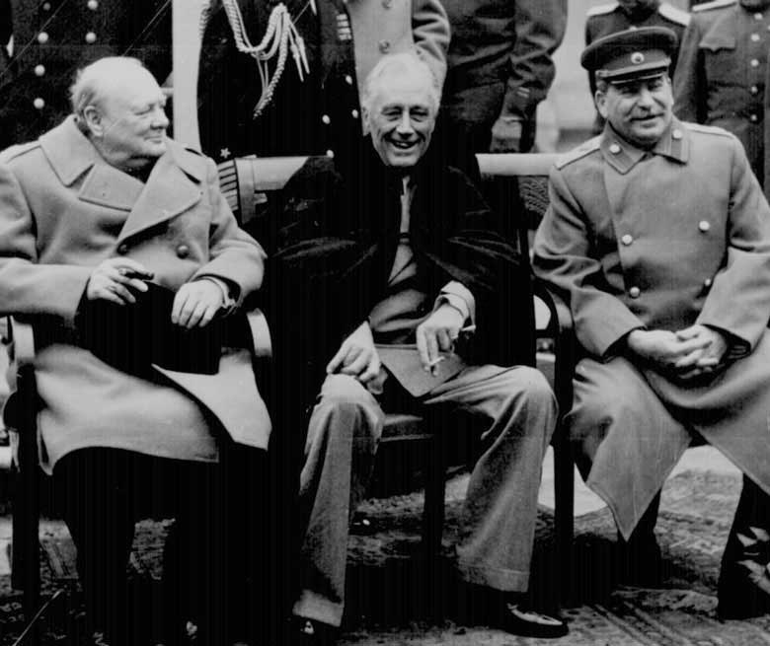
Allies set Postwar Goals at Yalta
The Big Three- Churchill, Stalin, and FDR meet in Yalta to discuss postwar Europe
Agreed that Poland, Bulgaria, and Romania would have free elections

Slide 8
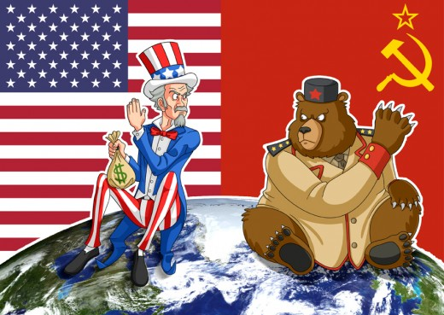
A New World Take Shape
The US and Russia emerge as superpowers
War helps the US recover from Great Depression

Slide 9
Creation of the United Nations
The US led the creation of the United Nations (UN)
An organization intended to prevent future conflicts

Slide 10
Universal Declaration of Human Rights
Issued by the UN
“Recognition of the inherent dignity and of the equal and inalienable rights of all members of the human family is the foundation of freedom, justice, and peace in the world… All human beings are born free an equal in dignity and rights. They are endowed with reason and conscience and should act toward one another in spirit of brotherhood.”
-Universal Declaration of Human Rights, The United Nations, 1948

Slide 11
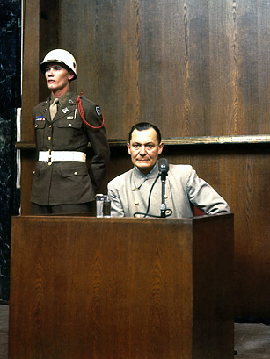
War Criminals Go on Trial
Many Axis powers violated the Geneva Convention, an international agreement governing the treatment of wounded soldiers and POW’s
The Allies prosecuted many Nazi and war criminals at the Nuremburg Trials

Slide 12
Show Me Time!!!
What was used in Hiroshima and Nagasaki by the US in an attempt to end WWII?
Where did the Big Three discuss postwar Europe?
What was created after the war to prevent future war?
Where were Nazi war criminals prosecuted?

